Slide 1
Apartment for rent – just refurbished!
High standard, superb location: Petrska ulice, Praha 2 – close to a tram station, Florenc metro, Municipal House, Petrska Tower
entrance hall 2.7m2
lounge 20.4m2
kitchen 4.7m2
hall 2.0m2
bathroom 1 2.6m2
gallery 3.2m2
bedroom 13.7m2
bathroom 2 7.6m2
balcony/gallery 5.0m2
Total: 61.9 m2

Slide 2
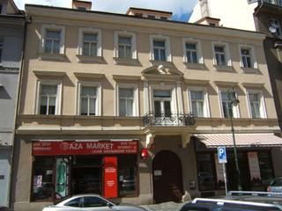
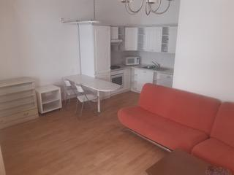
Photos
Notes:
2

Slide 3
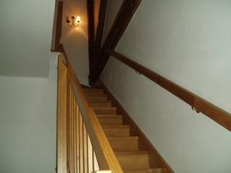
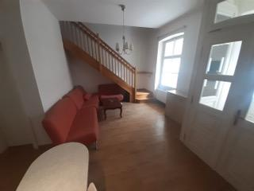
Photos
Notes:
3

Slide 4
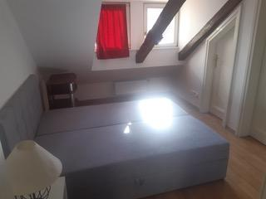
Photos
Notes:
4

Slide 5
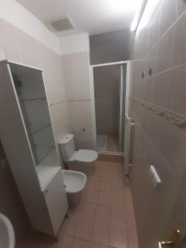
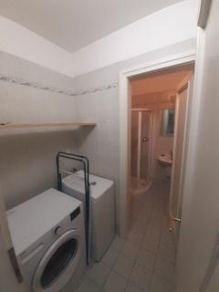
Photos
Notes:
5

Slide 6
Contact details
In case of interest or more questions, please contact Mrs Sona Cervenkova by emailing: socrv@seznam.cz
Notes:
6

